Slide 1
Lending Club
Team 1 Presentation

Slide 2
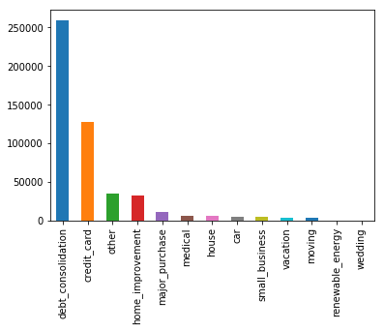
Debt Consolidation Loans
Lending Club Debt Consolidation Loans (2018)
Lending Club is considered one of America’s market place lenders that connect borrowers and investors; however, this type of organization is not considered traditional bank lending
The Lending Club data shows that the majority of the loans by category are debt consolidation loans
What is a debt consolidation loan?
It is a form of debt refinancing that entails taking out one loan to pay off many others

Slide 3
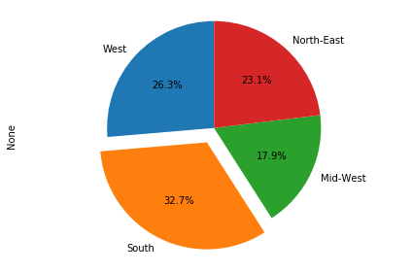
Debt Consolidation Loans by Region in 2018
Lending Club Debt Consolidation Loans by Region (2018)
It was interesting to see that debt consolidation was the highest type of loan, but what about by Region? What might be the drivers?
The data shows that by Region, the Southern population made up 35.3% of borrowers, West 24.9%, Northeast, 23% and Midwest 16.9%
In addition, to look at the drivers, we chose policy changes or differences of policy by State
When doing the research it was found that there is a driver to consider called “Installment Loans” which Lending Club offers
Lending Club offers installment loans at a 3 year interest rate based on the amount requested to fund

Slide 4
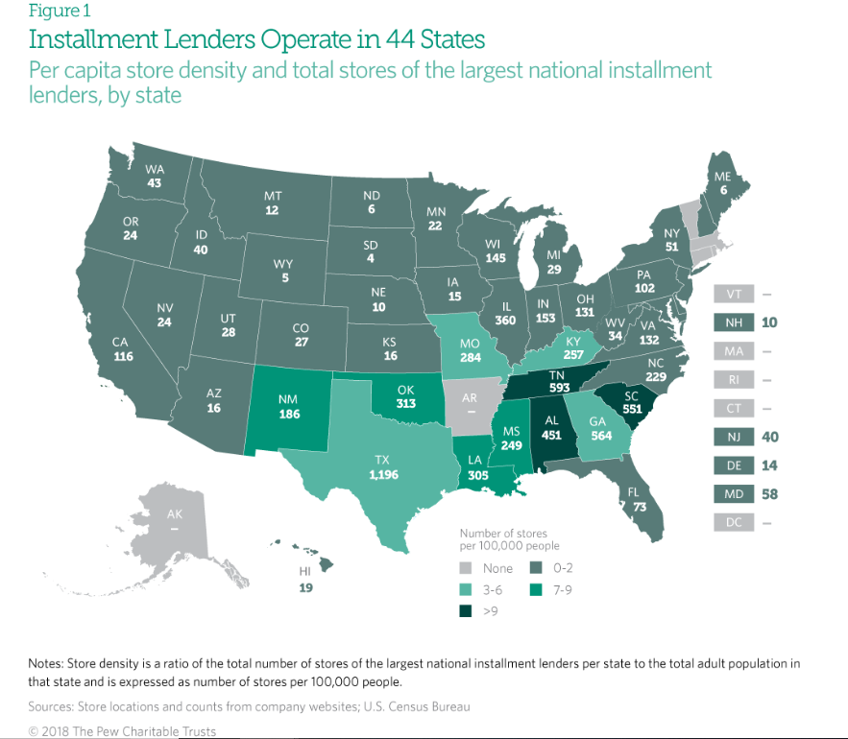
An installment loan is borrowed and paid over a specific amount of time.
The installment lending centers show how many operate by State
4,961 = Southern Region
1,175 = Midwest Region
570 = Western Region
267 = Northeastern Region
The data almost aligns with the lending club data with the exception of the Midwest.
Pew Research shows that States that allow interest rate caps with lump sum credit insurance with the loan (>1K) of financing of premiums are permitted show higher lending (AL, GA, KS, KY, LA, MS, NV, NC, SC)
Loans from States that allow an alternative fee structure for loans (<1.5K) and allow a 10% acquisition charge (OK, TN, AL, TX)
Credit insurance and other ancillary products increase the cost of borrowing in States that allow them by more than 1/3 on average
Installment Lenders by State(2018)

